Slide 1
Chapter 1

Slide 2
Artificial Intelligence
AI is one of the newest fields in science and engineering.
Work started in it after World War II, and the name itself was coined in 1956.

Slide 3
Definitions of AI
" ... the science of making machines do things that would require intelligence if done by humans" - Marvin Minsky
AI is the part of computer science concerned with designing intelligent computer systems -E. Feigenbaum
Science behind making Systems that can demonstrate human-like reasoning capability to enhance the quality of life and improve business competitiveness - Japan-S’pore AI Centre
John McCarthy (science and engineering )--common sense
Science behind Making machines do things that humans currently do
better (senses) AGI – artificial general intelligence Ray Solomonof

Slide 4

Turing’s Test
In 1950 Alan Turing published his now famous paper "Computing Machinery and Intelligence." In that paper he describes a method for humans to test AI programs.

Slide 5
Turing’s Test
Human, Machine & Judge.
If the computer succeeds in fooling the judge then it has managed to exhibit a human level of intelligence in the task of pretending to be a human , by the definition of intelligence the machine has shown itself to be intelligent.
Which one’s the computer?
A
B
Notes:
To pass Turing test, the computer should have the following:
• natural language processing to enable it to communicate successfully in English
• knowledge representation to store what it knows or hears;
• automated reasoning to use the stored information to answer questions and to draw
new conclusions;
• machine learning to adapt to new circumstances and to detect and extrapolate patterns.

Slide 6
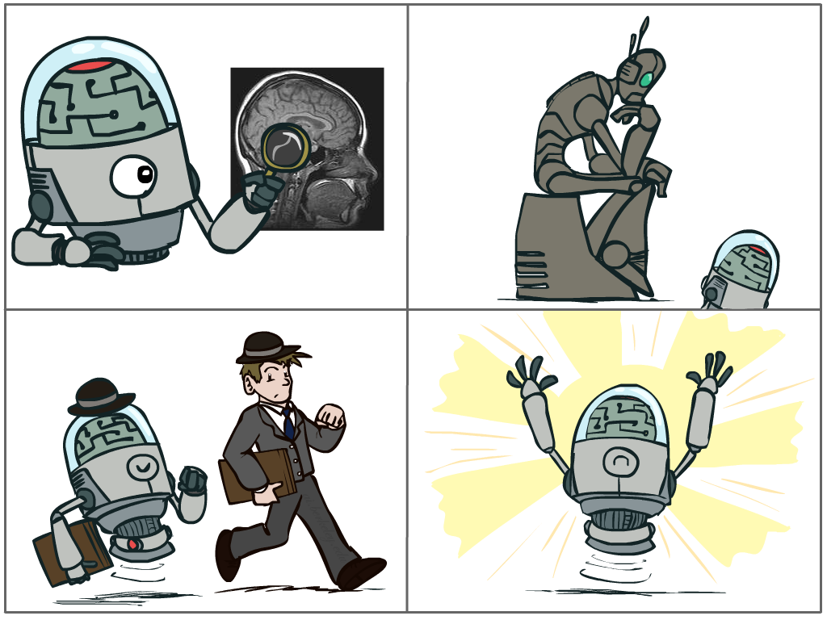
What is AI?(Definitions –IA-based)
The science of making machines that:
Think like people
Think rationally
Act like people
Act rationally

Slide 7
Rational Decisions
We’ll use the term rational in a very specific, technical way:
Rational: maximally achieving pre-defined goals
Rationality only concerns what decisions are made
(not the thought process behind them)
Goals are expressed in terms of the utility of outcomes
Being rational means maximizing your expected utility
Notes:
Example of utilities. 10 for A, 1 for each Friday with friends

Slide 8
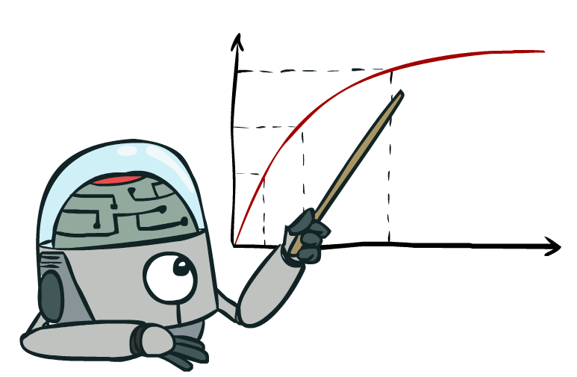
Maximize Your
Expected Utility

Slide 9
The foundations of AI
Philosophy (reasoning, planning, learning, science, automation)
Mathematics (logic, probability, optimization)
Neuroscience (neurons, adaptation)
Economics (rationality, game theory)
Control theory (feedback)
Psychology (learning, cognitive models)
Linguistics (grammars, formal representation of meaning)

Slide 10
A (Short) History of AI
1940-1950: Early days
1943: McCulloch & Pitts: Boolean circuit model of brain
1950: Turing's “Computing Machinery and Intelligence”
1950—70:
1950s: Early AI programs: chess, checkers (RL), theorem proving
1956: Dartmouth meeting: “Artificial Intelligence” adopted
1965: Robinson's complete algorithm for logical reasoning
1970—90: Knowledge-based approaches
1969—79: Early development of knowledge-based systems
1980—88: Expert systems industry booms
1988—93: Expert systems industry busts: “AI Winter”
1990— 2012: Statistical approaches + subfield expertise
Resurgence of probability, focus on uncertainty
General increase in technical depth
Agents and learning systems… “AI Spring”?
2012— ___: Big data, big compute, deep learning
AI used in many industries

Slide 11
AI Applications
Robotics
Games
Spam filtering
Autonomous Driving
Machine Translation
Chatbots
Recommender Systems

